Slide 1
Efficient Architectures
Oren Ben Kiki
Yair Ben Sahel

Slide 2
01.
Why?
02.
Designing Efficient Building Blocks
03.
(re-)Measuring Efficiency
04.
Guidelines for Efficient Architectures
05.
Scaling
2

Slide 3
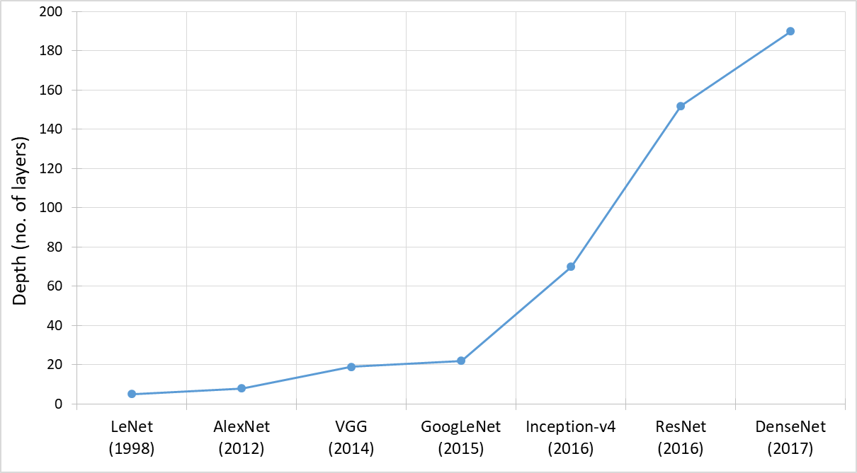
Why?
Source: Khan, Asifullah, et al. "A survey of the recent architectures of deep convolutional neural networks." (2019).
3

Slide 4
Deep Learning - on a budget
4

Slide 5
What can we do?
Design
Compress
Creating new types
of architectures
Shrinking existing models
(Pruning, hashing, etc.)
5

Slide 6
Back to Basics
Measuring Efficiency
Basic Building Blocks
Cost: Float-point operations (FLOPs)
Mult/Add operations
Efficiency: Accuracy vs. Cost
Convolutional Neural Networks
Basis for CV-oriented nets
Convolution operations are costly
6

Slide 7
CONVOLUTION OPERATIONS
MINIMUM
COST
*What about accuracy…?

Slide 8
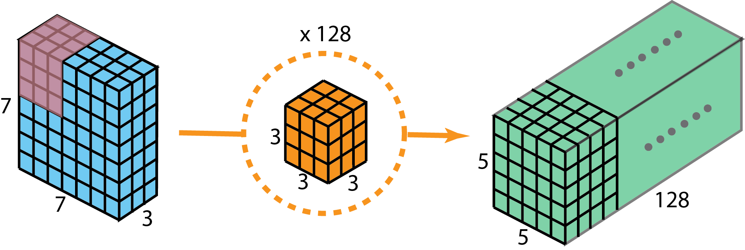
But how?
Input
Output
Filters
3-by-3 kernel
Applied over 3 input channels
Repeated for 128 output channels
5-by-5 feature maps
Summed over 3 input channels
Repeated for 128 output channels
8

Slide 9
Depth-wise & Point-wise Convolution (Decomposing the filter)
Depth-wise
Filter
Intermediate
output
Point-wise
Filter
Input
Output
3-by-3 kernel
Applied 1 per input channel
Repeated for 3 input channels
1-by-3 kernel
Applied over 3 intermediate outputs
Repeated for 128 output channels
9

Slide 10
Depth-wise & Point-wise Convolution
Accuracy
Cost
Less parameters
$⇓$
Limited Capacity
Significant (87%)
Decrease in FLOPs
$$r=\frac{1}{N_{c}}+\frac{1}{k^{2}}$$
($k$ – kernel size)
Neglible for $N_{c}≫1$
10

Slide 11
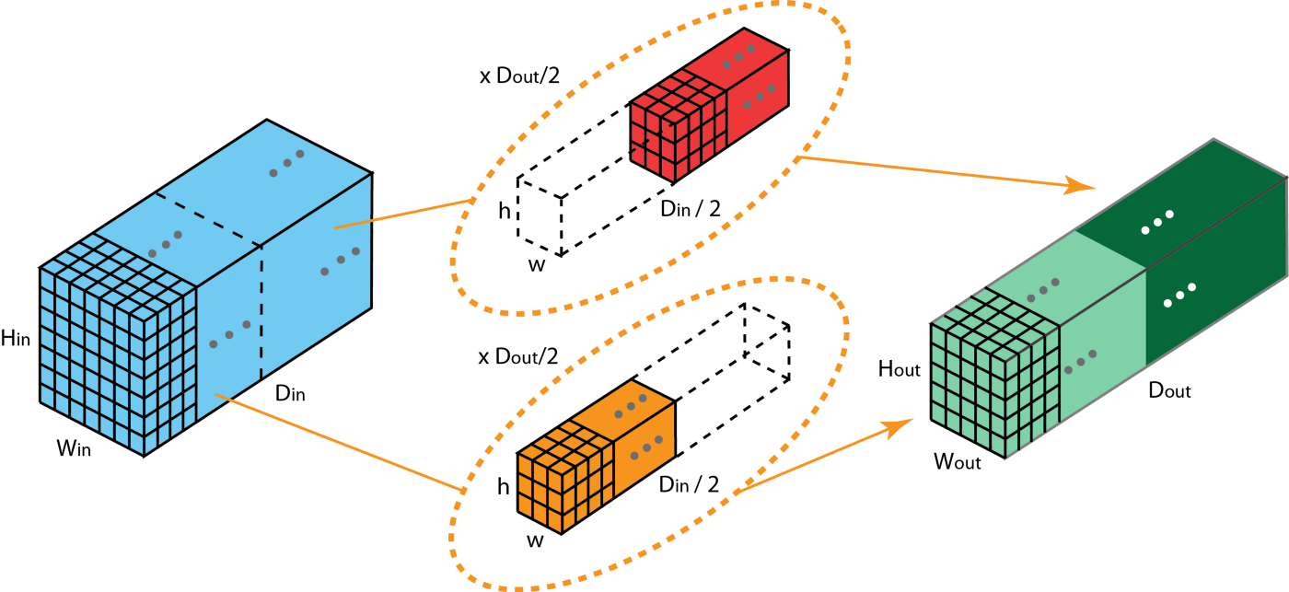
Group Convolution (Splitting & Merging)
Group 2 Filter
Input
Output
Group 1 Filter
11

Slide 12
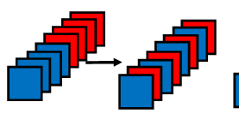
Group Convolution
Accuracy
Cost
Fewer inputs per filter
$⇓$
Limited representation
Half the amount
of FLOPs
$⇓$
More channels
for the same cost
Channel
Shuffle!
12

Slide 13
Bottlenecks (Adjusting the I/O)
Bottleneck: $N_{in} , N_{out}≫N_{b}$
Inverted Bottleneck: $N_{in} , N_{out}≪N_{b}$
N_{in}
1x1 Conv. filter
1x1 Conv. filter
Convolution
C_{in} = C_{out} = N_{b}
x N_{b}
x N_{out}
N_{out}
Input
Output
13

Slide 14
Bottlenecks
Bottleneck
Inverted Bottleneck
Reduced cost (small no. of I/O channels)
Limited expressiveness
Reduces cost of residual connections
Better expressiveness
Higher cost (large no. of I/O channels)
14

Slide 15
Mid-way Summary
Efficiency = Accuracy vs. Cost
Cost = counting operations (FLOPs)
Baseline: Convolutional Neural Networks
Goal: efficient convolutions. How?
Depth-wise & Point-wise conv.
Group conv. ( + channel shuffle)
Bottlenecks

Slide 16
There is no ‘winner-takes-it-all’ solution; Know your needs & Design accordingly

Slide 17
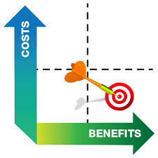
(re-)Measuring Efficiency
Recall: Efficiency = Accuracy vs. Cost
Cost == FLOPs
Training cost vs. inference cost?
Time needed on specific hardware?
→ False!
17

Slide 18
Measuring Cost
Cost factors: FLOPs, Memory operations, Parallel vs. Serial
Quality of implementation and optimization to specific hardware
Costs factors act as predictors to the actual cost:
Easier to measure, only as good as the model
18

Slide 19
Operation costs
Computer scale Human scale
~1 cycle (~1/3ns) ~1 second
x Few
Few cycles Few seconds
x Few
~10 cycles ~10 seconds
x 10
~100 cycles Few minutes
x Few
Few 100 cycles <10 minutes
x 100
Few 10,000 cycles ~10 hours
Operation
One integer operation
FLOP, Access L1 cache (Few * 10 KBs)
Access L2 cache (Few * 100 KB)
Access L3 cache (Few * MB)
Access memory (Few * GBs)
Access disk (Few * TBs)
19

Slide 20
G1: Equal no. of I/O Channels
For 1x1 point-wise convolutions, C_{in}= C_{out}➔ minimal MACs per FLOP
C_{in} > 1 C_{out} = 1
LDs FLOPs STs
Caveats:
Assumes caches are large enough
Assumes load and store bandwidth of the hardware is the same
C_{in} = 1 C_{out} > 1
LDs FLOPs STs
C_{in} = C_{out}
LDs FLOPs STs
20

Slide 21
G2: Avoid Excessive Group convolutions
Group convolutions reduce FLOPs/channel, but increase MACs/FLOP
Group size = 1
LDs FLOPs STs
Caveats:
Group convolutions may allow the active layers to fit into the cache
Group size > 1
LDs FLOPs STs
21

Slide 22
G3: Avoid Excessive Fragmentation
A series of small convolutions increases accuracy, but reduces parallelism (also increases MACs/FLOPs)
Fragmented
Input 3x3 Temp. 3x3 Out
Caveats:
Parallelism applies more to GPU hardware than to CPU hardware
Parallelism applies more to inference than to training, if multiple images fit into the GPU memory
Unified
Input 5x5 Output
22

Slide 23
G4: Element-wise operations are Important
Element-wise operations (ReLU, Bias, Batch Normalization, etc.) can make up a large fraction of the overall runtime
(Simple) element-wise operations tend to have ~1 MACs/FLOPs
The HW for matrix operations and the HW for element-wise operations “tends” to be “separate” and moving data between them may be costly
Caveats:
A series of element-wise operations can (and should) be “fused” to minimize MACs/FLOPs
23

Slide 24
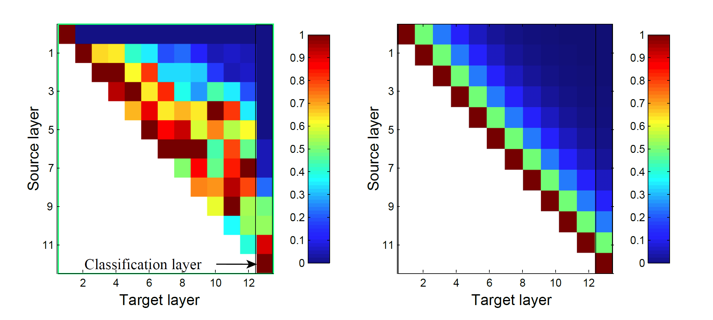
“G5”: Avoid excessive feature reuse
Feature reuse passes unmodified data between layers, which increases accuracy – up to a point
If “too much” data in adjacent layers is similar, then the layers perform redundant “similar” computation
DenseNet ShuffleNet2
Caveat:
Much more “abstract” guideline
24

Slide 25
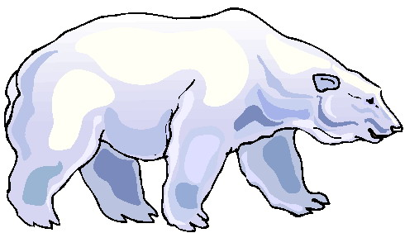
“G6”: Use the right data type
Narrow data types → less time (given hardware support)
Float 32 / Float 16 / Bfloat 16 / Float 8 / Float19 (TF32) / …
Int 32 / Int 16 / Int 8 / Int 4 / Int 2 / Int 1
Caveats:
Training requires wider data types (for back-propagation gradients)
25

Slide 26
What Now?

Slide 27
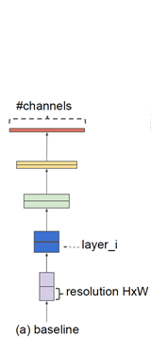
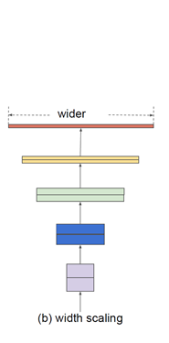
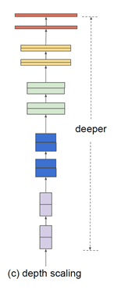
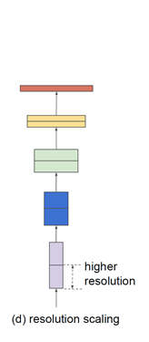
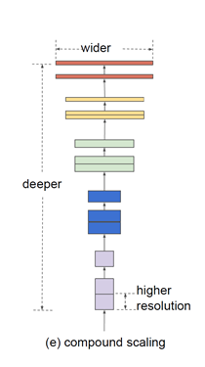
Scaling
Given more resources, how do you scale to gain the most accuracy?
More channels (width scaling)
More layers (depth scaling)
Bigger input (resolution scaling)
How to choose the right mixture?
27

Slide 28
Costs of scaling
FLOPs cost grows:
Linearly with depth (α)
Quadratically with width (β)
Quadratically with resolution (γ)
β
Output
Input
α
γ
β
γ
β
β
Filter
28

Slide 29
Benefits of Scaling
Depth → complex features
Width and/or Resolution → finer grained features
Scaling each improves accuracy – up to a point
Requires a balanced approach
Scaling Width
Scaling Depth
Scaling Resolution
29

Slide 30
Compound Scaling
Once:
Choose “best” α, β, γ ≥ 1 such that α * β² * γ² = 2 by running a search algorithm maximizing accuracy for doubling baseline cost
To scale:
Pick Φ = log₂ (target cost / baseline cost), scale depth by α^{Φ}, width by β^{Φ}, resolution by γ^{Φ}
Caveats:
Does not consider memory accesses, only FLOPs
Optimal proportions may vary with scale
30

Slide 31
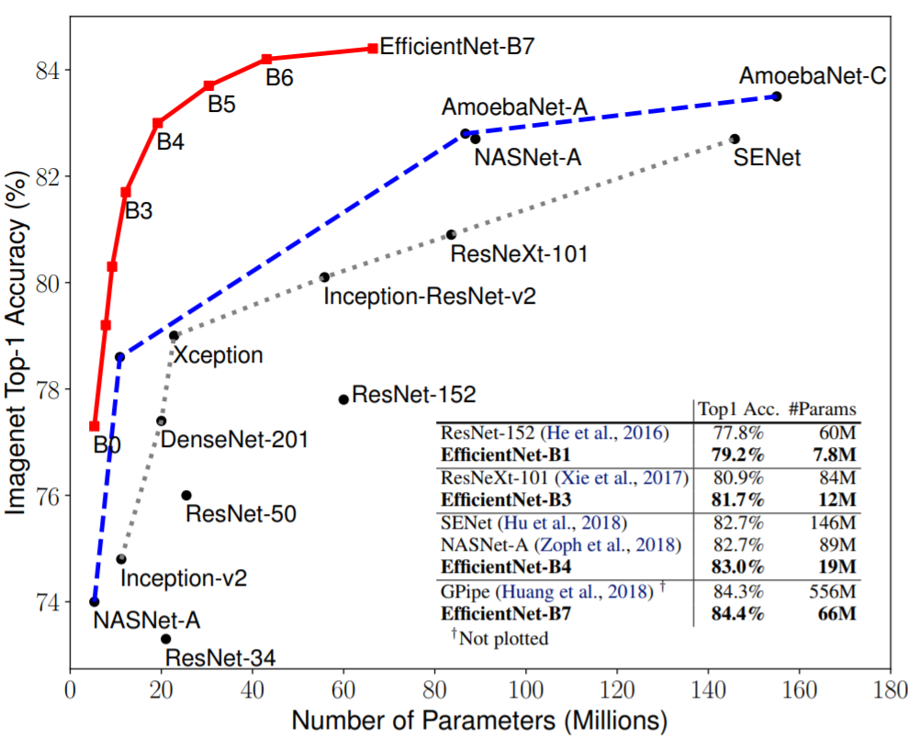
Combining it all
Following the guidelines helps improve baseline efficiency
Scaling increases accuracy but runs into diminishing returns
31

Slide 32
Summary
Architecture determines Efficiency (Accuracy vs. Cost)
Cost isn’t just counting FLOPs
There are many ways to design more efficient nets
Each way has different tradeoffs
Given more resources, we can apply scaling
Network architecture is still more of an art than science

Slide 33
What Now?

Slide 34
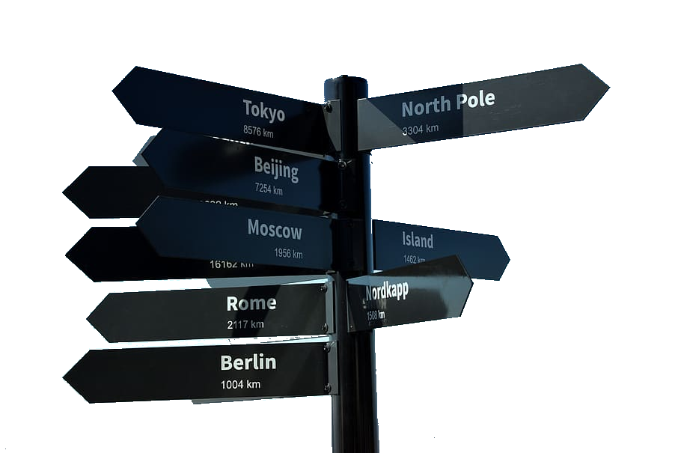
Many directions
Novel architectures
Sparse networks
Spiking networks
More…
34

Slide 35
Thank you for Listening!

